Slide 1
Azure 데이터
Dae Woo Kim (daewoo.kim@)
Technology Evangelist
Microsoft Korea

Slide 2
Agenda
SQL Database
SQL Server VM
DocumentDB
Search
HDInsight
Additional Databases
Notes:
The Azure data Platform is HUGE and growing. This session will have to be brief about some of this content and make a few deep dives here and there.

Slide 3
SQL Database
Notes:
Now let’s focus on Microsoft Azure SQL Database the PaaS service!

Slide 4

Microsoft Relational Storage Options
제공되는 다양한 서비스
Physical
Virtual
IaaS
PaaS
프라이빗 클라우드부터 제공
Notes:
Slide Objectives:
Show Microsoft’ continuous Private to Public Cloud Offering, but this presentation will focus on Microsoft’s relational database PaaS offering.
Transition:
Microsoft provides a continuous solution from private cloud to the public cloud. No matter where you are on your technology roadmap we have a solution to fit your needs.
We are a trusted advisor and platform in the traditional enterprise and ISV space with new IaaS offerings that making it easier to bring this same level of trust and ease of use to the public cloud. However, Microsoft Azure SQL Database extends SQL Server capabilities to the cloud by offering SQL Server as a relational database service.
Speaking Points:
SQL Database provides SQL Server as a relational service.

Slide 5
Architecture
기초부터 시작

Slide 6
서버는 가상 환경
SQL Server
Machine
(Physical/VM)
Azure
SQL Database Server
TDS Endpoint
Notes:
Slide Objectives:
Understand that while there are physical SQL Server boxes behind the scenes, when connecting to SQL Database, you are not connecting to a physical server, but to a TDS endpoint.
Transition:
The key to understanding SQL Database is understanding while SQL Database is SQL Server, we do not interact with them in the same physical manner.
Speaking Points:
In an on-premises environment, we typically have physical access to the actual SQL Server server.
In Microsoft Azure, we do not have physical access to the actual server.
Notes:
It is important that the attendee understands that it IS INDEED SQL Server at the platform layer. There are physical boxes running SQL Server 2012 Enterprise Edition. However, due to the nature of the Azure environment to provide the high-availability and scalability necessary, access to the physical boxes is currently not supported.

Slide 7
SQL Database 기초
SQL Server 데이터베이스 기술의 “서비스화＂
관리되는 서비스
엔터프라이즈 환경을 지원 HA, DR, Backups, replication 등
Notes:
Slide Objectives:
Understand the overall concepts and benefits of SQL Database
Transition:
Let’s clear up any confusion and look at the basics of what SQL Database really is and some of its benefits.
Speaking Points:
The same great SQL Server database technology that you know, love, and use on-premises provided as a service
Enterprise-ready
Automatic support for High-Availability
Designed to scale on-demand to provide the same great elasticity
Notes:
High-availability – 3 copies of the database free for the cost of the one database. Always in sync. The cost to do this on-premises isn’t cheap. This is FREE in SQL Database.

Slide 8
SQL Database 기초
ElasticScale 기술로 수평확장(Scale out)
추가적인 데이터 보호를 위한, 내장된 지역 데이터베이스 복사본
99.99%의 SLA 보장
Notes:
Slide Objectives:
Understand the overall concepts and benefits of SQL Database
Transition:
Let’s clear up any confusion and look at the basics of what SQL Database really is and some of its benefits.
Speaking Points:
The same great SQL Server database technology that you know, love, and use on-premises provided as a service
Enterprise-ready
Automatic support for High-Availability
Designed to scale on-demand to provide the same great elasticity
Notes:
High-availability – 3 copies of the database free for the cost of the one database. Always in sync. The cost to do this on-premises isn’t cheap. This is FREE in SQL Database.

Slide 9
서비스 아키텍처
Client Layer
PHP
SQL Server
Applications
and Tools
WCF Data Services
어플리케이션은 TDS 프로토콜로 SQL Database와 통신
ODBC
ADO.NET
Tabular Data Stream (TDS)
Notes:
Client - The client layer resides closest to your application, and is used by your application to communicate directly with SQL Database. The client layer can reside on-premise in your datacenter or be hosted in Microsoft Azure. Because SQL Database provides the same tabular data stream (TDS) interface as SQL Server, you can use familiar tools and libraries to build client applications for data that is in the cloud.

Slide 10
서비스 아키텍처
Client Layer
PHP
SQL Server
Applications
and Tools
WCF Data Services
ODBC
ADO.NET
Tabular Data Stream (TDS)
TDS+SSL
클라이언트와 플랫폼 레이어간 게이트웨이
Services Layer
Provisioning
Billing and Metering
Connection Routing
Notes:
Services - The services layer functions as a gateway between the client layer and the platform layer, where the data resides. The services layer provides three functions: provisioning, billing and metering, and connection routing.
The services layer provisions the databases that you specify with your Microsoft Azure platform account. The billing and metering aspect of the services layer enables multi-tenant support by providing monitoring and billing for database usage based on individual Microsoft Azure platform accounts. SQL Database is built on a scalable platform involving numerous physical servers; this layer handles all the connections routing between your application and the physical servers where your data resides.

Slide 11
서비스 아키텍처
Client Layer
PHP
SQL Server
Applications
and Tools
WCF Data Services
ODBC
ADO.NET
Tabular Data Stream (TDS)
TDS+SSL
Services Layer
Provisioning
Billing and Metering
Connection Routing
서비스 레이어 지원 및 물리적인 서비스
Platform Layer
SQL Server
SQL Database Fabric
Management Services
Notes:
Platform - The platform layer includes the physical servers and services that support the services layer. The platform layer consists of many instances of SQL Server, each of which is managed by the SQL Database fabric.
The SQL Database fabric is a distributed computing system composed of tightly integrated networks, servers, and storage. It enables automatic failover, load balancing, and automatic replication between physical servers.
Management services monitor the health of individual servers and enable automated installation of service upgrades and software patches.

Slide 12
서비스 아키텍처
Client Layer
PHP
SQL Server
Applications
and Tools
WCF Data Services
ODBC
ADO.NET
Tabular Data Stream (TDS)
TDS+SSL
Services Layer
Provisioning
Billing and Metering
Connection Routing
Platform Layer
SQL Server
SQL Database Fabric
실제 하드웨어와 OS 관리
Management Services
Infrastructure Layer
Notes:
Infrastructure - The infrastructure layer represents the IT administration of the physical hardware and operating systems that support the services layer.

Slide 13
서비스 아키텍처
Client Layer
PHP
SQL Server
Applications
and Tools
WCF Data Services
ODBC
ADO.NET
Tabular Data Stream (TDS)
TDS+SSL
Services Layer
Provisioning
Billing and Metering
Microsoft Azure SQL Database
PaaS
Connection Routing
Platform Layer
SQL Server
SQL Database Fabric
Management Services
Infrastructure Layer
Notes:
Slide Objectives:
To understand the actual architecture that provides the enterprise-ready SQL Database service.
Transition:
Developers have spent years working with their technology of choice, and Microsoft wanted to ensure that the technologies and tools you use today will continue to work with SQL Database without learning a whole new set of technologies.
Speaking Points:
Familiar technology and tools
Similar architecture as that of on-premises
Additional layer providing server and database partitioning, client connection routing, and billing.
Same great SQL Server technology on the backend.
Additional services (SQL Database Fabric) to ensure SLAs are met and to ensure optimum performance.

Slide 14
SQL Database Server
자동으로 생성된 데이터베이스 서비스로 생성시 master 데이터베이스를 포함
FQDN: {name}.database.windows.net
Notes:
Slide Objectives:
Show the different methods of provisioning a SQL Database server along with how easy it is. Plus, help the attendees understand what a SQL Database “server” really is.
Transition:
Provisioning an on-premises SQL Server box can be time consuming, costly, and at times, a challenge. With SQL Database, provisioning a “server” is painless, quick, and provisioned in a matter of seconds.
Speaking Points:
Provision servers interactively using the Management Portal
Automate server provisioning using the Microsoft Azure Management API or PowerShell.
Notes:
While the “server” is technically a TDS endpoint, much of the SQL Server process is similar. Administration login credentials are still needed for security, and more importantly defining service access is essential, and required, for maintaining the integrity of your server through firewall rules.

Slide 15






Server 접속
IP Based Firewall Rules
SQL Database Server
Allow Azure Services
Full Access
Selective Access
Azure Services
Notes:
Slide Objectives:
Explain SQL Server Database Connectivity.
Speaking Points:
Explain how data is protected using server-level firewall and database-level firewall rules.
Explain the difference when services connecting to SQL Databases from the internet versus services connecting from the Azure Datacenters.

Slide 16
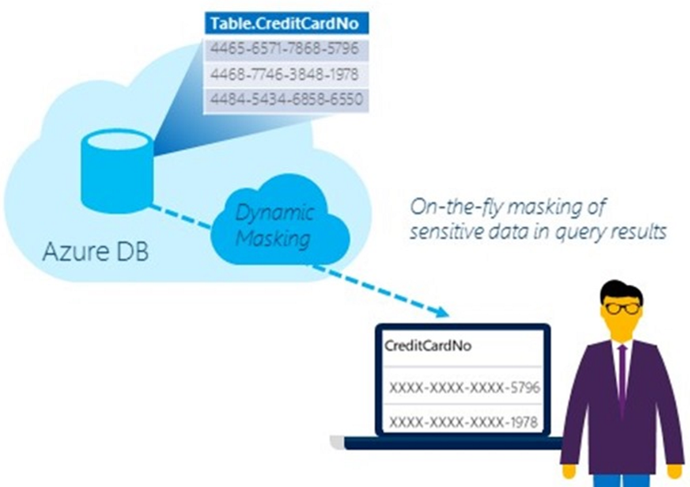
동적 데이터 마스킹(Dynamic Data Masking)
민감한 자료 노출 제한
비인가 접근 방지
정책 기반 보안 – 어플리케이션에 변경 없음
일반적인 컴플라이언스 확충
민감한 데이터에 대한 유출 없이 개발/테스트 가능
Protect Sensitive Data
Limit Exposure of Sensitive Data
Notes:
Speaker notes:
Limit sensitive data(e.g. customer or PII) exposure by masking data to non-privileged users in real time
Limit the exposure of sensitive data to meet industry compliance policies
Policy-based security feature hides the sensitive data in the result set of a query over designated database fields, while the data in the database is not changed and as a result require no changes to the Application layer.
A developer can query production environments for troubleshooting purposes without violating compliance regulations

Slide 17
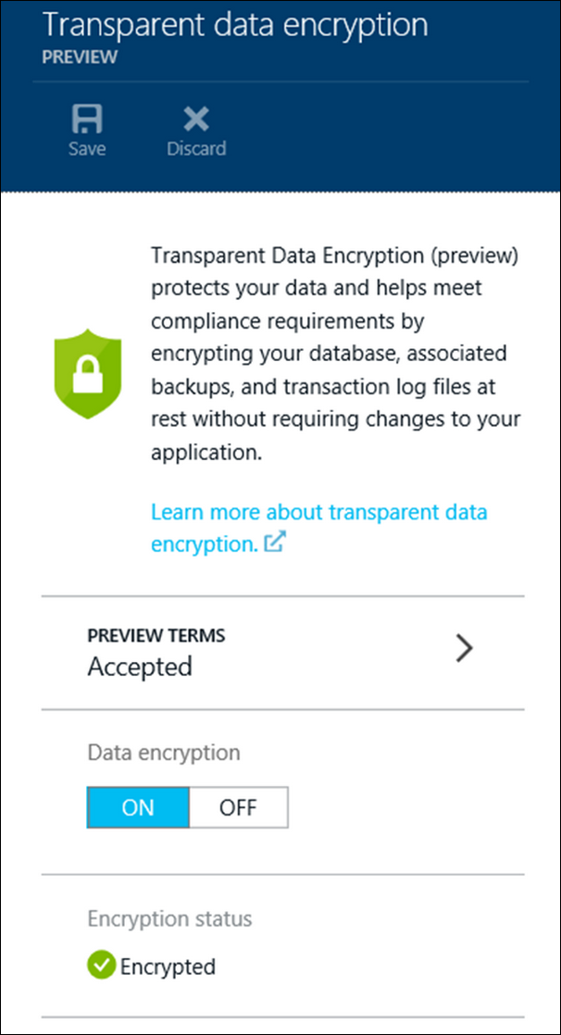
Transparent Data Encryption (TDE)
데이터베이스, 백업, 트렌젝션 로그를 암호화
2-click 프로비전 서비스 제공
공격 범위를 줄임
기존 어플리케이션에 코드 변경 없음
데이터베이스 암호화 키 - AES-256
컴플라이언스 요건 충족
하드웨어 암호화에 의한 속도 증가
Encrypt and Protect Database
Notes:
Speaker notes:
Protect your data by encrypting your database, associated backups, and transaction log files at rest in real-time without requiring changes to your application
Help you meet regulatory compliance
An entire database is encrypted by using an industry standard AES-256 symmetric key by the service
Easy as a 2 clicks to provision the service and all key management for database copying, Geo-Replication, and database restores anywhere in SQL Database is handled by the service
Support for Intel AES-NI hardware acceleration of encryption. This will reduce the CPU/DTU overhead of turning on Transparent Data Encryption

Slide 18
로우 레벨 보안(Row-Level Security) – RLS
로우들에 대한 접근 제어
데이터베이스에 포함된 제안 로직으로 접근
보안에 대한 개발 작업을 단순화
컴플라이언스 요건 충족
보안상 공격 노출 범위를 감소
Fine-grained Access Over Rows
Notes:
Speaker notes:
Allow for data protection when multiple users or applications need to access different records in the same database tables. For example, implement restrictions on data rows to users pertinent to their department or restricting a customer's data access to only the data relevant to their company.
The access restriction logic is located in the database tier rather than away from the data in another application tier. Simplifies the design and coding of security in your application
Makes your security system more reliable and robust by reducing the surface area of your security system

Slide 19
다른 주요 서비스
Contained Database Users
Parallel Queries
Common Language Runtime (CLR) assemblies
Fine-grained Access Over Rows
Notes:
Speaker Notes:
SQL Database authenticate at the database level by using contained database users making databases more portable
Parallel Queries support heavier workloads
Author stored procedures, triggers, user-defined functions, user-defined types, and user-defined aggregates in managed code

Slide 20
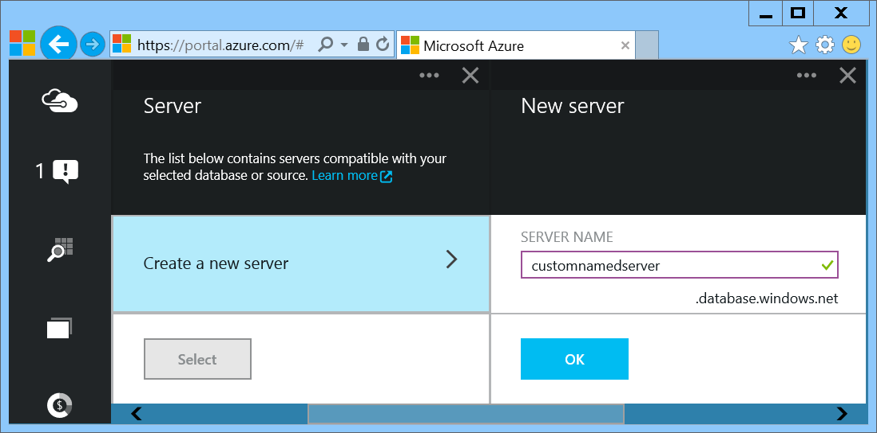
서버들을 배포
SQL Database server 생성
Notes:
Important: In the Preview Management Portal you are able to create a custom server FQDN! In the Management Portal that name is randomized.
Slide Objectives:
Show the different methods of provisioning a SQL Database server along with how easy it is. Plus, help the attendees understand what a SQL Database “server” really is.
In the Preview Portal you can select the name of the server you create!
Transition:
Provisioning an on-premises SQL Server box can be time consuming, costly, and at times, a challenge. With SQL Database, provisioning a “server” is painless, quick, and provisioned in a matter of seconds.
Speaking Points:
Provision servers interactively using the Management Portal
Automate server provisioning using the Microsoft Azure Management API or PowerShell.
Notes:
While the “server” is technically a TDS endpoint, much of the SQL Server process is similar. Administration login credentials are still needed for security, and more importantly defining service access is essential, and required, for maintaining the integrity of your server through firewall rules.

Slide 21
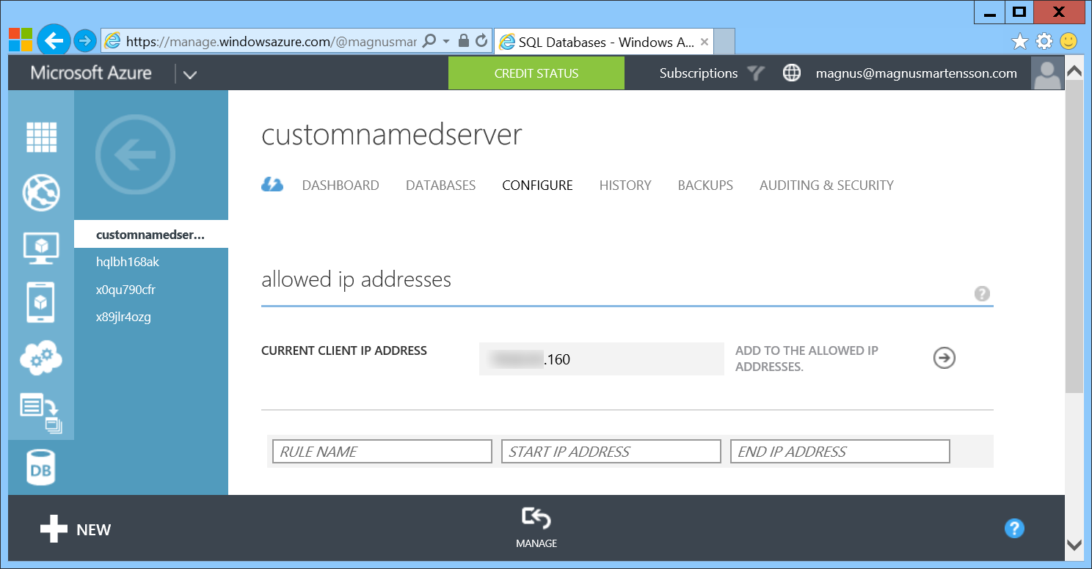
서버들을 배포
In the Management Portal add firewall rules
Notes:
Slide Objectives:
Show how to configure IP-Filtering in the firewall for the SQL Database Server.

Slide 22
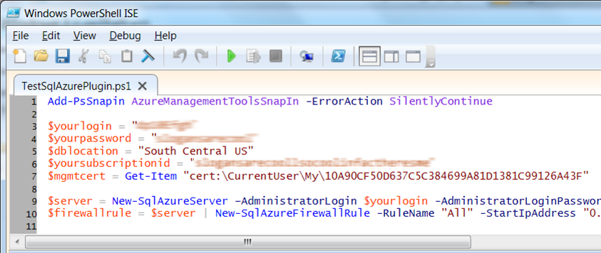
서버 배포 자동화
Microsoft Azure Platform 파워쉘 cmdlets
http://bit.ly/azurepowershell
Notes:
Slide Objectives:
Show the different methods of provisioning a SQL Database server along with how easy it is. Plus, help the attendees understand what a SQL Database “server” really is.
Transition:
Provisioning an on-premises SQL Server box can be time consuming, costly, and at times, a challenge. With SQL Database, provisioning a “server” is painless, quick, and provisioned in a matter of seconds.
Speaking Points:
Provision servers interactively using the Management Portal
Automate server provisioning using the Microsoft Azure Management API or PowerShell.
Notes:
While the “server” is technically a TDS endpoint, much of the SQL Server process is similar. Administration login credentials are still needed for security, and more importantly defining service access is essential, and required, for maintaining the integrity of your server through firewall rules.

Slide 23
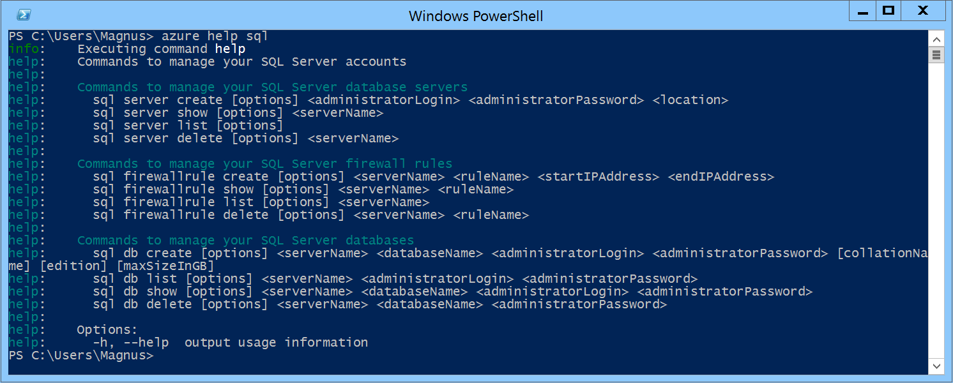
서버 배포 자동화
Azure 크로스 플랫폼 Command-Line 인터페이스 (xplat-cli)
http://bit.ly/azurexplatcli
Notes:
Slide Objectives:
Show the different methods of provisioning a SQL Database server along with how easy it is. Plus, help the attendees understand what a SQL Database “server” really is.
Transition:
Provisioning an on-premises SQL Server box can be time consuming, costly, and at times, a challenge. With SQL Database, provisioning a “server” is painless, quick, and provisioned in a matter of seconds.
Speaking Points:
Automate server provisioning using the Microsoft Azure Management API or PowerShell or xplat-cli.

Slide 24
Demo: SQL Database Server 와 SQL Database 생성
Notes:
Demo 1)

Slide 25
적합한 SQL Database 선택
Service Tier | Performance Level | Common App Pattern | Performance |  |  | Business Continuity
 |  |  | Max DB Size | Transaction Perf. Objective | DTU | PITR | DR / GEO-Rep
Basic | Basic | Small DB, SQL opp | 2 GB | Reliability / Hr. | 5 | 7 Days | DB Copy + Manual Export
Standard | S0 S1 S2 | Wrkgp/cloud app, multiple concurrent operations | 250 GB | Reliability / Min. | 10 20 50 | 14 Days | DB Copy + Manual Export
Premium | P1 P2 P3 | Mission Critical, High volume, Many concurrent Users | 500 GB | Reliability / sec. | 100 200 800 | 35 Days | Active Geo-replication
다양한 P 시리즈 환경 추가됨
Notes:
Slide Objectives:
Highlight what’s new in the latest SQL Database service update.
Transition:
In late September a service update was deployed to Microsoft Azure SQL Database that included new functionality.
Speaking Points:
Linked Server – This is a new component for database hybrid solutions spanning on-premises corporate networks and the Microsoft Azure cloud.
Recursive Trigger – Just like SQL Server 2012, the option can be configured via ALTER DATABASE dbname SET RECURSIVE_TRIGGERS ON|OFF
DBCC – The query optimizer uses statistics to estimate the cardinality or number of rows in the query result, which enables the query optimizer to create a high quality query plan.
Firewall Rules – different rules for different databases hosted on the same logical SQL Database server
Notes:

Slide 26
매 5분마다 자동으로 트렌젝션 로그를 백업
Azure 저장소와 지리적 복제 위치에 백업
백업 retenstion 정책 7, 14 또는 35일
장기 보관이 필요한 백업본 보호를 위한 data export 논리 백업 자동화 가능
Point-in-time 복구

Slide 27
모든 서비스 티어에서 사용 가능 Basic, Standard 및 Premium
geo-redundant Azure 저장소에서 사용
아무 지역(region)에서 복구 가능
Geo-restore – 긴급 장애 복구
Notes:
Emergency data recovery when you need it most

Slide 28
Opt-in for Standard & Premium databases
Creates a stand-by secondary
Replicate to pre-paired Azure region
Automatic data replication, asynchronous
Opt-in via REST API, PowerShell or Azure Portal
Microsoft-managed, RTO<24h, RPO<1 hr
표준 geo-replication
Notes:
RTO Recovery time objective http://en.wikipedia.org/wiki/Recovery_time_objective
RPO Recovery point objective http://en.wikipedia.org/wiki/Recovery_point_objective

Slide 29
Self-service activation in Premium
Create up to 4 readable secondaries
Replicate to any Azure region
Automatic data replication, asynchronous
REST API, PowerShell or Azure Portal
RTO<1h, RPO<5m, you choose when to failover
Active geo-replication
Notes:
RTO Recovery time objective http://en.wikipedia.org/wiki/Recovery_time_objective
RPO Recovery point objective http://en.wikipedia.org/wiki/Recovery_point_objective

Slide 30
Configurable to track & log database activity
Dashboard views in the portal for at-a-glance insights
Pre-defined Power View reports for deep visual analysis on Audit log data
Audit logs reside in your Azure Storage account
Available in Basic, Standard, and Premium
Auditing
Notes:
Gain insight into database events & streamline compliance-related tasks

Slide 31
Full-Text Search
Fast and flexible indexing of textual data
Data types: char, varchar, nchar, nvarchar, text, ntext, image, xml, varbinary(max), or FILESTREAM
Handles high query volume
Common use cases:
Searching websites, product catalogs, news items and more
Document management systems
Any applications that need to provide search capabilities over data stored in a SQL Database
Notes:
Speaker notes:
Full-Text Search allows fast and flexible indexing for keyword-based query of text data stored in tables with columns of following data types: char, varchar, nchar, nvarchar, text, ntext, image, xml, or varbinary(max)
Full-text queries can include simple words and phrases or multiple forms of a word or phrase.
A full-text query returns any documents that contain at least one match (also known as a hit). A match occurs when a target document contains all the terms specified in the full-text query, and meets any other search conditions, such as the distance between the matching terms.
Full-text queries perform linguistic searches against text data in full-text indexes by operating on words and phrases based on rules of a particular language such as English or Japanese
A full-text query returns any documents that contain at least one match (also known as a hit). A match occurs when a target document contains all the terms specified in the full-text query, and meets any other search conditions, such as the distance between the matching terms.
Full-text search is applicable to a wide range of business scenarios such as e-businesses—searching for items on a web site; law firms—searching for case histories in a legal-data repository; or human resources departments—matching job descriptions with stored resumes.

Slide 32
XML Indexes
XML Indexes - improves XQuery-based query performance
Primary XML Index - speed up access to elements and attributes
CREATE PRIMARY XML INDEX XML_Order_Items
ON Sales.Order (Items);
Secondary XML Index – help resolve specific XQuery expressions rapidly
Notes:
Slide objective:
XML indexes speedup XQuery-based query response
Speaker notes:
An XML index is like a copy of an XML object tree that is saved into the database for rapid reuse rather than an object created in memory and traversed during query time which is a relatively slow process.
Before you can create a primary XML index on a table, the table must have a clustered primary key.
Secondary indexes are designed to speed up a particular type of query such as PATH, VALUE, and PROPERTY indexes:
A PATH index helps to decide whether a particular path to an element or attribute is valid. It is typically used with the exist() XQuery method.
A VALUE index helps to obtain the value of an element or attribute.
A PROPERTY index is used when retrieving multiple values through PATH expressions.

Slide 33
Dynamic Management Views (DMV)
Monitor common database, execution and transaction related events in near-real time
Diagnose blocked or long-running queries, resource bottlenecks, poor query plans, and more
Help improve capacity planning
Use familiar T-SQL language
Notes:
Slide objective:
Emphasize Azure SQL Database service has extremely rich environment for monitoring the status of your databases using DMVs.
Speaker notes:
Microsoft Azure SQL Database partially supports three categories of dynamic management views:
Database-related dynamic management views (indexes, partitions and waits)
Execution-related dynamic management views (connections, sessions, requests) Transaction-related dynamic management views (transactions and locks)
Identify expensive queries and gain an understanding of long running queries
View the status of your query within the execution plan
Detect the queries that run for long may be getting throttled by Azure SQL Database service
Monitor the size of transactions and transaction log usage
Helps with capacity planning - If these percentages remain near 100% utilization, you should consider improving performance by scaling out, scaling up, or optimizing your database design.

Slide 34
Demo: 배포한 SQL Database에 연결
Notes:
Demo 2)

Slide 35
익숙한 SQL 쿼리 기술 사용
Transact-SQL
Notes:
Slide Objectives:
Point out that 1) The same great technologies that developers use today on-premises works with SQL Database 2) high-level differences between on-premises and SQL Database 3) SQL Database features currently unsupported
Transition:
Creating, managing, and deploying a database in Microsoft Azure SQL Database isn’t difficult. The key is understanding the features that are supported and how SQL Database compares to on-premises SQL Server and the technologies that can be used with SQL Database.
Speaking Points:
The same great technologies that developers use today on-premises works with SQL Database, including developer languages, Frameworks, and Tools. Nothing new to learn!
SQL Server Comparison -> highlight the physical vs. logical administration. Developers and DBAs can now focus on things they love to do and not worry about the physical aspect.
Features unsupported by SQL Database -> Many of the unsupported features are hardware based and thus don’t need to be in SQL Database. Other features, such as encryption, are server-based and become a challenge in solving in a shared-environment.
Notes:
CLR data types ARE supported, SQLCLR is not yet supported.
Backup/Restore: PIT Coming; Import/Export can be used for backup to BLOB storage. Third-party backup products available via RedGate and Enzo.
Data can be stored encrypted but the encryption must be done at the application level.
Native encryption is being looked at.
**Linked Servers and Distributed Queries are now supported, linking a SQL Database instance from an on-premises server. Linking two SQL Database instances is NOT supported.

Slide 36
익숙한 언어를 이용해 DB에 접근
.NET Framework (C#, Visual Basic, F#): ADO.NET
C / C++: ODBC
Java: Microsoft JDBC provider
PHP: Microsoft PHP provider
.NET Framework (C#, Visual Basic, F#): ADO.NET
C / C++: ODBC
Java: Microsoft JDBC provider
PHP: Microsoft PHP provider
Notes:
Slide Objectives:
Point out that 1) The same great technologies that developers use today on-premises works with SQL Database 2) high-level differences between on-premises and SQL Database 3) SQL Database features currently unsupported
Transition:
Creating, managing, and deploying a database in Microsoft Azure SQL Database isn’t difficult. The key is understanding the features that are supported and how SQL Database compares to on-premises SQL Server and the technologies that can be used with SQL Database.
Speaking Points:
The same great technologies that developers use today on-premises works with SQL Database, including developer languages, Frameworks, and Tools. Nothing new to learn!
SQL Server Comparison -> highlight the physical vs. logical administration. Developers and DBAs can now focus on things they love to do and not worry about the physical aspect.
Features unsupported by SQL Database -> Many of the unsupported features are hardware based and thus don’t need to be in SQL Database. Other features, such as encryption, are server-based and become a challenge in solving in a shared-environment.
Notes:
CLR data types ARE supported, SQLCLR is not yet supported.
Backup/Restore: PIT Coming; Import/Export can be used for backup to BLOB storage. Third-party backup products available via RedGate and Enzo.
Data can be stored encrypted but the encryption must be done at the application level.
Native encryption is being looked at.
**Linked Servers and Distributed Queries are now supported, linking a SQL Database instance from an on-premises server. Linking two SQL Database instances is NOT supported.

Slide 37
익숙한 프레임워크를 이용해 DB에 접근
OData
Entity Framework
WCF Data Services
NHibernate (etc.)
Notes:
Slide Objectives:
Point out that 1) The same great technologies that developers use today on-premises works with SQL Database 2) high-level differences between on-premises and SQL Database 3) SQL Database features currently unsupported
Transition:
Creating, managing, and deploying a database in Microsoft Azure SQL Database isn’t difficult. The key is understanding the features that are supported and how SQL Database compares to on-premises SQL Server and the technologies that can be used with SQL Database.
Speaking Points:
The same great technologies that developers use today on-premises works with SQL Database, including developer languages, Frameworks, and Tools. Nothing new to learn!
SQL Server Comparison -> highlight the physical vs. logical administration. Developers and DBAs can now focus on things they love to do and not worry about the physical aspect.
Features unsupported by SQL Database -> Many of the unsupported features are hardware based and thus don’t need to be in SQL Database. Other features, such as encryption, are server-based and become a challenge in solving in a shared-environment.
Notes:
CLR data types ARE supported, SQLCLR is not yet supported.
Backup/Restore: PIT Coming; Import/Export can be used for backup to BLOB storage. Third-party backup products available via RedGate and Enzo.
Data can be stored encrypted but the encryption must be done at the application level.
Native encryption is being looked at.
**Linked Servers and Distributed Queries are now supported, linking a SQL Database instance from an on-premises server. Linking two SQL Database instances is NOT supported.

Slide 38
익숙한 도구들을 이용해 접근
SQL Server Management Studio (>=2008 R2)
SQL Server command-line utilities (SQLCMD, BCP)
Visual Studio IDE for database development
Notes:
Slide Objectives:
Point out that 1) The same great technologies that developers use today on-premises works with SQL Database 2) high-level differences between on-premises and SQL Database 3) SQL Database features currently unsupported
Transition:
Creating, managing, and deploying a database in Microsoft Azure SQL Database isn’t difficult. The key is understanding the features that are supported and how SQL Database compares to on-premises SQL Server and the technologies that can be used with SQL Database.
Speaking Points:
The same great technologies that developers use today on-premises works with SQL Database, including developer languages, Frameworks, and Tools. Nothing new to learn!
SQL Server Comparison -> highlight the physical vs. logical administration. Developers and DBAs can now focus on things they love to do and not worry about the physical aspect.
Features unsupported by SQL Database -> Many of the unsupported features are hardware based and thus don’t need to be in SQL Database. Other features, such as encryption, are server-based and become a challenge in solving in a shared-environment.
Notes:
CLR data types ARE supported, SQLCLR is not yet supported.
Backup/Restore: PIT Coming; Import/Export can be used for backup to BLOB storage. Third-party backup products available via RedGate and Enzo.
Data can be stored encrypted but the encryption must be done at the application level.
Native encryption is being looked at.
**Linked Servers and Distributed Queries are now supported, linking a SQL Database instance from an on-premises server. Linking two SQL Database instances is NOT supported.

Slide 39
지원하지 않는 SQL Server 기능
Use 명령, 분산 트렌젝션, 분산 뷰
Service Broker
SQL Agent
SQL Profiler
Native Encryption
Notes:
Slide Objectives:
Point out that 1) The same great technologies that developers use today on-premises works with SQL Database 2) high-level differences between on-premises and SQL Database 3) SQL Database features currently unsupported
Transition:
Creating, managing, and deploying a database in Microsoft Azure SQL Database isn’t difficult. The key is understanding the features that are supported and how SQL Database compares to on-premises SQL Server and the technologies that can be used with SQL Database.
Speaking Points:
The same great technologies that developers use today on-premises works with SQL Database, including developer languages, Frameworks, and Tools. Nothing new to learn!
SQL Server Comparison -> highlight the physical vs. logical administration. Developers and DBAs can now focus on things they love to do and not worry about the physical aspect.
Features unsupported by SQL Database -> Many of the unsupported features are hardware based and thus don’t need to be in SQL Database. Other features, such as encryption, are server-based and become a challenge in solving in a shared-environment.
Notes:
CLR is now supported: http://azure.microsoft.com/blog/2014/12/11/preview-available-for-next-generation-of-azure-sql-database/
Backup/Restore: PIT Coming; Import/Export can be used for backup to BLOB storage. Third-party backup products available via RedGate and Enzo.
Data can be stored encrypted but the encryption must be done at the application level.
Native encryption is being looked at.
**Linked Servers and Distributed Queries are now supported, linking a SQL Database instance from an on-premises server. Linking two SQL Database instances is NOT supported.

Slide 40
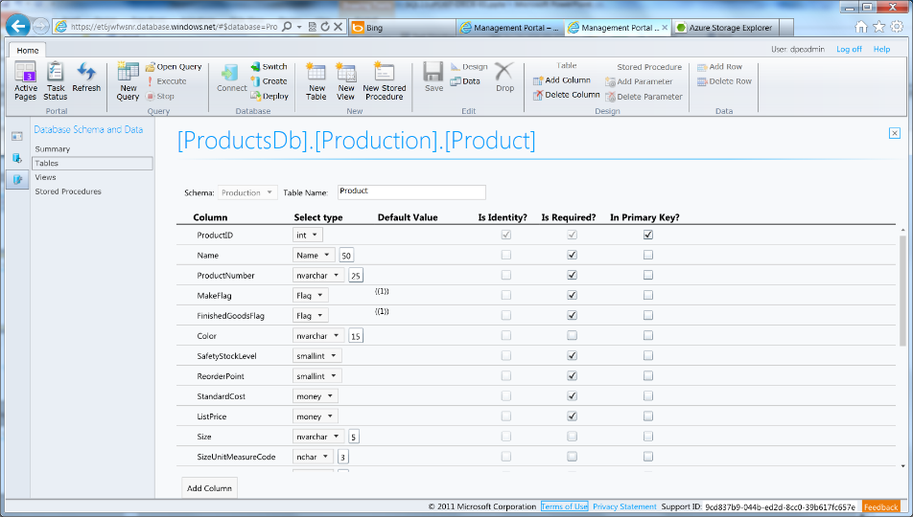
Azure SQL Database Management Portal
테이블, 뷰, 저장프로시져를 제작하기 위한 웹 디자이너 도구를 이용해 쿼리 수정 및 실행
Notes:
Slide Objectives:
Highlight the set of tools for developers when interacting with Microsoft Azure SQL Database.
Transition:
Transition statement(s) to setup the slide
Speaking Points:
SQL Database Management Portal -> Cross Browser, Unified Management Experience
SQL Server Data Tools -> Integrated Database Design Environment, Table Designer, Debugging, T-SQL Editor
Notes:
IntelliSense in T-SQL Editor
SQL Server Data Tools
Strive to make it consistent as possible
Intersection with the cloud
Bridging you to the new cloud world
Consistency to the new developer experience
Consistency with the new cloud model

Slide 41
Demo: DAC Deployment From SQL Server Management Studio
Notes:
Demo 3)

Slide 42

Elastic Database

Slide 43
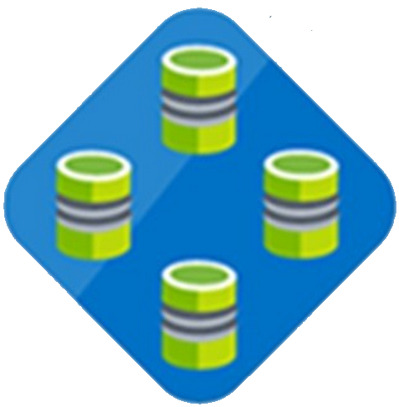

Elastic Database Pool
Elastic Database
Pool
Elastic Database
많은 수의 SQL Database를 배포하기 위한 예측가능한 모델
Notes:
Speaker notes:
Elastic pools simplify the process of creating, maintaining, and managing both performance and cost for large numbers of Azure SQL databases.
Manage large numbers of databases that have unpredictable resource demands.
Ability to run centralized queries and reporting tools across database pool.

Slide 44
Elastic Database 모델
Elastic databases, Elastic database pools
여러 데이터베이스들이 pool의 리소스로 사용됨
표준(standard) elastic pool 은 200~1200 eDTU를 100* database까지 지원
Standard elastic pool provides 200-1200* eDTUs for up to 100* databases
Elastic Standard databases는 100 eDTU까지 확장 가능 (S3 level)
pool 생성과 설정은 portal, PowerShell, REST API를 이용해 가능
databases 이동은 using portal, PowerShell, REST APIs, T-SQL로 가능
Databases 은 온라인으로 유지됨
모니터링 및 경고는 pool과 databases 양쪽에서 수행됨
Max per-database burst level
eDTUs
200
400
800
1200
*Additional pricing tiers may be introduced, and the ranges and limits may be increased during the preview

Slide 45
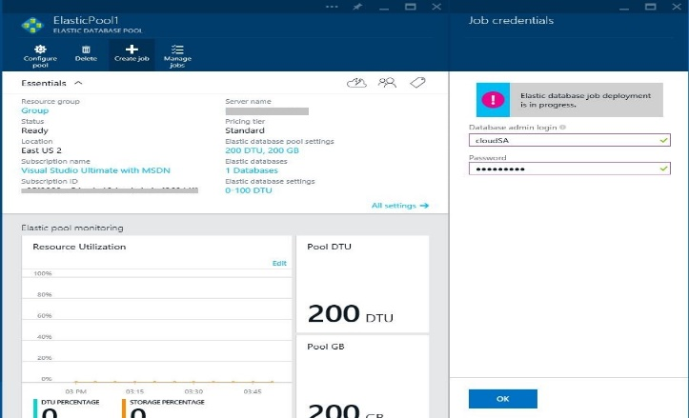
Elastic Database Jobs
ELASTIC DATABASE JOBS
SQL
SQL
SQL
T-SQL Scripts
SQL
ELASTIC DATABASE POOL
개별 데이터베이스들에서 관리 작업이 수행되나 개별 연결은 필요 없음.
Notes:
Speaker notes:
Execute administrative tasks across each database
Don’t have to connect to each database independently in order to run T-SQL statements or perform other administrative tasks
For example, you can easily update the schema in every database to include a new table
Elastic database jobs handles the task of logging in, and reliably running the script for you, while logging the status of execution for each database

Slide 46
많은 수의 database를 관리
변경이나 관리 작업이 많은 database에서 적용됨
익숙한 T-SQL 구문을 job 생성에 사용
자동 재연결 로직 포함
Azure 포털에서 elastic pool과 함께 사용
배치 처리 작업을 위해 디자인
Elastic Database Jobs

Slide 47
Elastic Scale
Notes:
This section is optional. If you have an audience with a specific interest in this there are many more slides hidden in a section at the end!

Slide 48
Canonical cloud app architecture
전형적인 3-tier 아키텍처
프론트엔드의 수평확장은 간단
데이터 티어의 확장은 어려움
Notes:
Classic 3-tier enterprise architecture
Requires to scale to 10000s users and process TBs of relational data
Scaling out (and in, elastically) web and worker tiers is relatively easy
How to scale data-tier if hard limits of the biggest scale unit (e.g. P3 instance) are reached: both storage size and throughput?

Slide 49
SQL Database 고려사항
Elastic Scale - sharding을 통해 수천개의 database까지 확장
Shard 패턴을 지원하고, .NET client를 활용
개발자 기능과 관리 기능을 제공
데이터에 대한 split, merge, 및 move 작업 지원

Slide 50
Azure SQL DB의 확장 옵션
Vertical: Scale-up 또는 scale-down
Horizontal: Scale-out 또는 scale-in
Premium
Premium
Standard
Standard
Scale up/down
Basic
Basic
Basic
Basic
Basic
Basic
Basic
Scale out/in
Notes:
Vertical: Change service-tiers for a given database as capacity needs fluctuate
Horizontal: Add or remove databases as more or less capacity is needed
Animation:
We start off with 3 basic databases
[click]: We can vertically scale one of these to a standard instance
[click]: We can also add more instances by scaling horizontally
[click]: If an instance need more headroom, we can always still vertically scale

Slide 51
Elastic Scale 아키텍처

Slide 52
SQL Server VM
Notes:
Now let’s focus on SQL Server in a Microsoft Azure Virtual Machine!

Slide 53
VM에서 SQL 실행
클라우드 VM에서 SQL 실행
SQL Server, Oracle, MySql 등을 지원
Gallery의 VM 이미지를 이용해 즉시 배포 가능
VM에 디스크 추가(attach) 가능
VM과 연계된 여러 SQL 엔진의 기능을 사용 가능

Slide 54
두개의 다른 SQL 엔진
SQL IaaS
SQL Database

Slide 55
SQL Database
SQL IaaS
관리 비용을 줄이고 elastic scale과 같은 기능이 필요할때
고객이 추가적인 IT 인력을 기술지원이나 유지보수에 쓰고 싶지 않을 경우
SQL VM 전체 기능을 사용하는 어플리케이션일 경우
고객사에 기술지원이나 유지보수가 가능한 IT 인력이 있을 경우

Slide 56
SQL IaaS는 지원하나 SQL Database에서 아직 지원하지 않는 기능
전체 SQL Server 기능 (e.g. Reporting Services)
윈도 인증(VM은 on-premise의 도메인에 가입 가능)
더 큰 데이터베이스 크기(16TB)
Notes:
Note: Full-Text Search now supported https://msdn.microsoft.com/library/ms142571.aspx

Slide 57
Demo: Standing up a SQL Server in Azure using Marketplace
Notes:
Demo 4)

Slide 58
DocumentDB
Notes:
Now let’s focus on the new Microsoft Azure DocumentDB Service!

Slide 59
관리되고 확장 가능한 JSON Database Service

Slide 60


Microsoft Azure Data Services
SQL Server in a VM
SQL Database
DocumentDB
Tables
Blobs
fully managed, scalable, queryable, schemafree JSON document database service for modern applications
fully featured RDBMS
transactional processing
rich query
managed as a service
elastic scale
schema-free data model
internet accessible http/rest
arbitrary data formats

Slide 61
MongoDB
DocumentDB
마이그레이션 할 수 없는 기존 어플리케이션이 있을 경우
고객사에 기술지원이나 유지보수가 가능한 IT 인력이 있을 경우
Mongo MMS 호환
관리되는 elastic scale 기능과 스키마 없는 데이터 쿼리, native JSON/Javascript 지원이 필요한 어플리케이션에 적합
고객사에 기술지원이나 유지보수가 가능한 IT 인력이 없을 경우
클라우드 데이터베이스 기술로 제작

Slide 62
동시성 조절 – 네가지 설정
Strong Bounded Stateless Session Eventual
Notes:
Configurable consistency to trade off consistency and performance.
Database Accounts are configured with a default consistency level.
Consistency level can be weakened per read/query request.

Slide 63
Tunable Consistency Strong
All writes are visible to all readers. Writes synchronously committed by a majority quorum of replicas and reads are acknowledged by the majority read quorum.

Slide 64
Tunable Consistency Bounded Stateless
Guaranteed ordering of writes, reads adhere to minimum freshness. Writes are propagated asynchronously, reads are acknowledged by majority quorum lagging by at most K prefixes.

Slide 65
Tunable Consistency Session
Read your own writes. Writes are propagated asynchronously while reads for a session are issued against the replica that can serve the requested version.

Slide 66
Tunable Consistency Eventual
Reads eventually converge with writes. Writes are propagated asynchronously while reads can be acknowledged by any replica. Readers may view older data then previously observed.

Slide 67
Tunable Consistency
 | Writes | Reads
Strong | sync quorum writes | quorum reads
Bounded | async replication | quorum reads
Session | async replication | session bound replica
Eventual | async replication | any replica
*
* | Ideal consistency and performance tradeoff for many application scenarios. High performance writes and reads with predictable consistency.

Slide 68
Partitioning Data
Hash Range Lookup
Notes:
Speaker notes:
Achieve near-infinite scale in terms of storage and throughput by horizontally partitioning data(sharding)
Best partition option for data across collections will depend on data format and access patterns
DocumentDB accounts can be scaled linearly with cost via collections

Slide 69
Partitioning Hash
Partitions are assigned based on the value of a hash function, allowing you to evenly distribute requests and data across a number of partitions
Notes:
Speaker notes:
This is commonly used to partition data produced or consumed from a large number of distinct clients, and is useful for storing user profiles, catalog items, and IoT ("Internet of Things") telemetry data.
You should use hash partitioning whenever there are too many entities to enumerate through lookup partitioning (e.g. users or devices) and the request rate is fairly uniform across entities.
Hash partitioning is useful for uniform load balancing of requests to make effective use of your provisioned storage and throughput. Using consistent hashing algorithms allow you to minimize the amount of data that has to be moved when adding or removing a partition.

Slide 70
Partitioning Range
Partitions are assigned based on whether the partition key is within a certain range.
Notes:
Speaker notes:
This is commonly used for partitioning with time stamp properties (e.g., eventTime between Feb 1, 2015 and Feb 2, 2015).
You should use Range partitioning if your queries are restricted to specific range values against the partition key.
Range partitioning is generally used in the context of dates, as it gives you an easy and natural mechanism for aging out partitions by timestamp. It is also useful when queries are generally constrained to a time range since that is aligned with the partitioning boundaries.

Slide 71
Partitioning Lookup
Partitions are assigned based on a lookup map that assigns discrete partition values to specific partitions a.k.a. a partition or shard map.
Notes:
Speaker notes:
This is commonly used for partitioning by region (e.g. the partition for Scandinavia contains Norway, Denmark, and Sweden).
Lookup partitioning offers the highest degree of control in managing a multi-tenant application. You can assign multiple tenants to a single collection, single tenant to a single collection, or even a single tenant across multiple collections.
Lookup partitioning allows you to group and organize unordered and unrelated sets of data in a natural way e.g., group tenants by organization or states by geographic region. Lookup also offers fine-grained control for migrating data between collections.

Slide 72
Demo: Interacting with DocumentDB
Notes:
Demo 5)

Slide 73
Search
Notes:
Time for the Microsoft Azure Search as a Service offering!

Slide 74
Azure Search
Embed a sophisticated search experience into web and mobile applications without having to worry about the complexities of full-text search and without having to deploy, maintain or manage any infrastructure.
Notes:
Azure Search is a fully managed search solution that allows developers to enable search experiences in applications.

Slide 75
Azure Search
기업의 클라우드 개발자, 클라우드 기반 개발사, 아키텍트 등 관리되는 search 솔루션이 필요할때 최선의 선택

Slide 76
Search Functionality
단순한 HTTP/JSON API 로 색인, 문서 업데이트, 검색이 가능
사용자 친화적인 키워드 검색 선언자 이용 가능(+, -, *, “”, etc.)
Hit highlighting
Faceting (histograms over ranges, typically used in catalog browsing)

Slide 77
Search Functionality
Suggestions (자동 컴파일)
검색과 조합되는 다양한 구조적 쿼리 (filter, select, sort) 지원
모델검색 결과 유사도에 따른 scoring profile
필터링, 정렬, 랭킹과 통합된 Geo-spatial 지원

Slide 78
Demo: Azure Search walkthrough
Notes:
Demo 6)

Slide 79
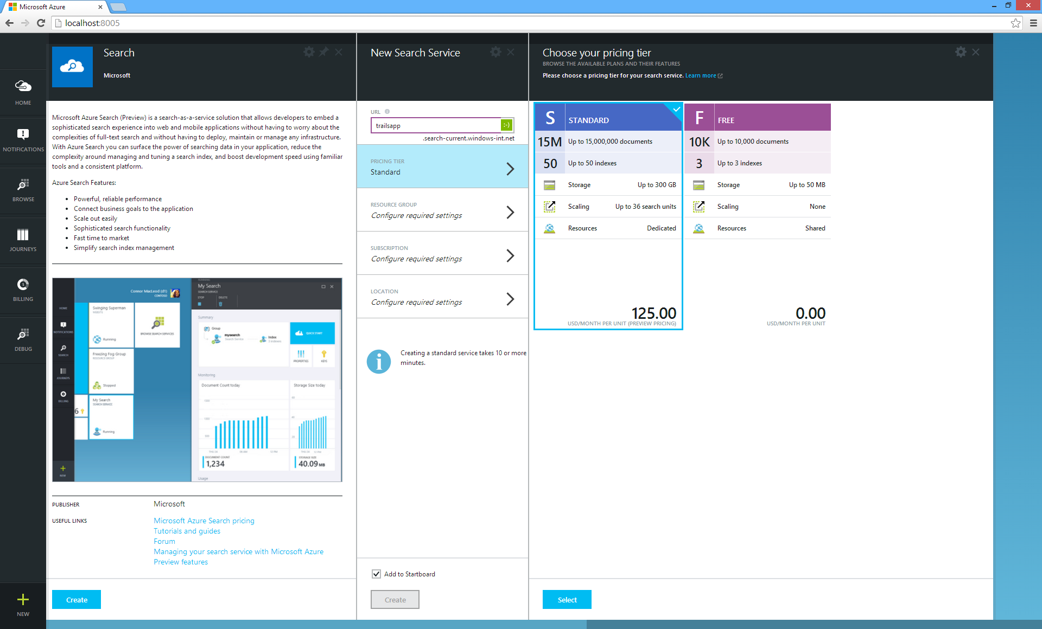
Choose Tier
Notes:
In the Azure Portal choose ”new +” -> ”Search”.
Pricing tier is either Standard or Free where the latter naturally is useful for functional development tests.

Slide 80
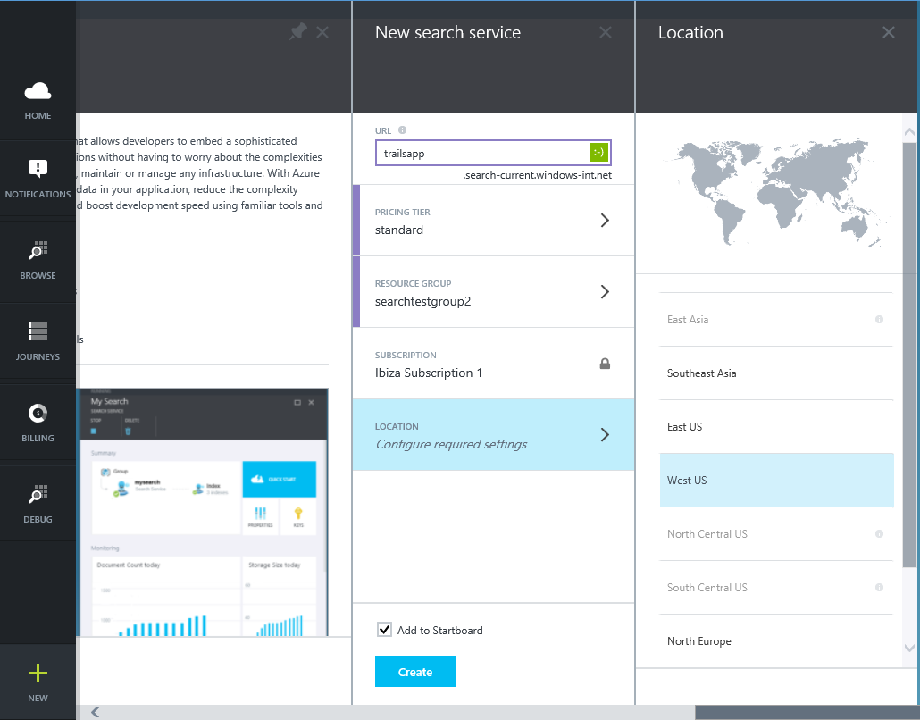
Global Availability
Notes:
Pick a location for the service.

Slide 81
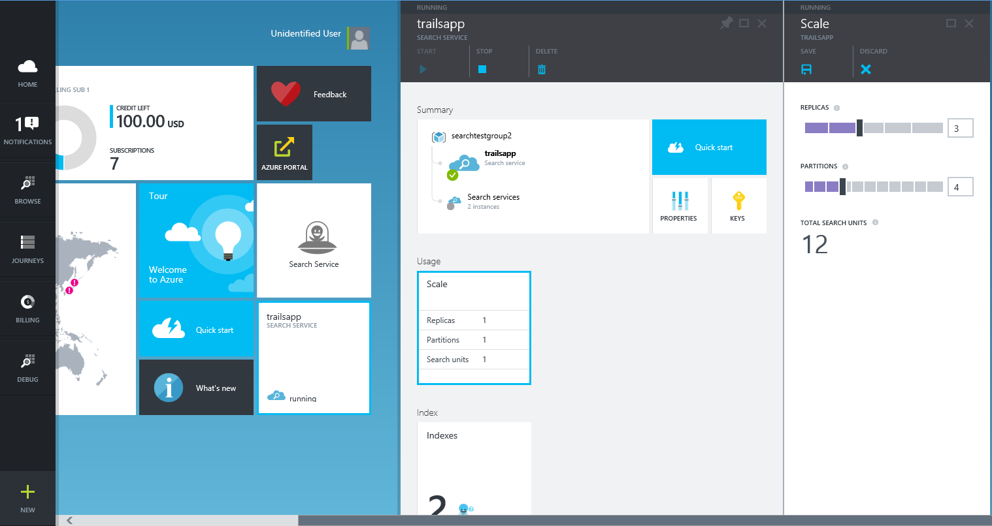
Scale Up

Slide 82
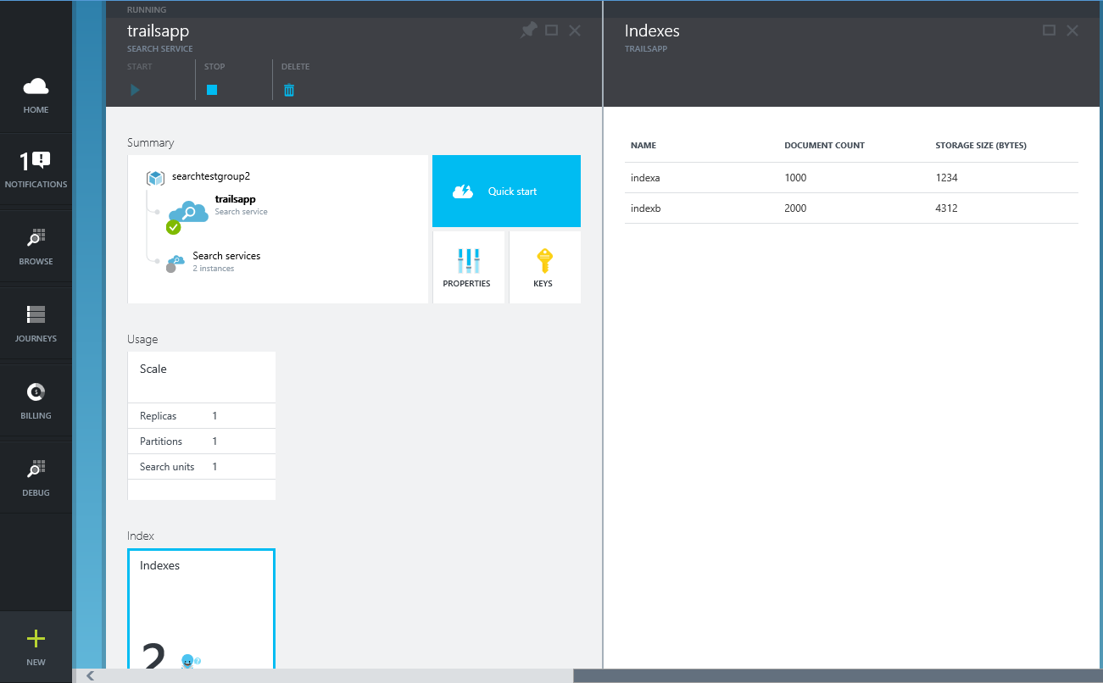
Manage Indexes

Slide 83
HDInsight
Notes:
Now let’s focus on Hadoop in Azure known as Microsoft Azure HDInsight!

Slide 84
Relational DB vs. Hadoop
Data size | Gigabytes (Terabytes) | Petabytes (Hexabytes)
Access | Interactive and Batch | Batch
Updates | Read / Write 다수 실행 | Writ는 한번, Read 다수 실행
Structure | 정적 스키마 | 동적 스키마
Integrity | High (ACID) | Low
Scaling | 비선형(Nonlinear) | 선형(Linear)
Reference: Tom White’s Hadoop: The Definitive Guide

Slide 85
HDInsight 개발 – 기존 개발 생태계 활용
Hive
Pig
Mahout
Cascading
Scalding
Scoobi
Pegasus
…

Slide 86
HDInsight 개발 – Microsoft .NET
C#
F#
Map/Reduce
Microsoft .NET management clients

Slide 87
HDInsight 개발 – DevOps / IT Pros
PowerShell
Cross-Platform CLI tools (xplat-cli)

Slide 88
Data Warehousing

Slide 89
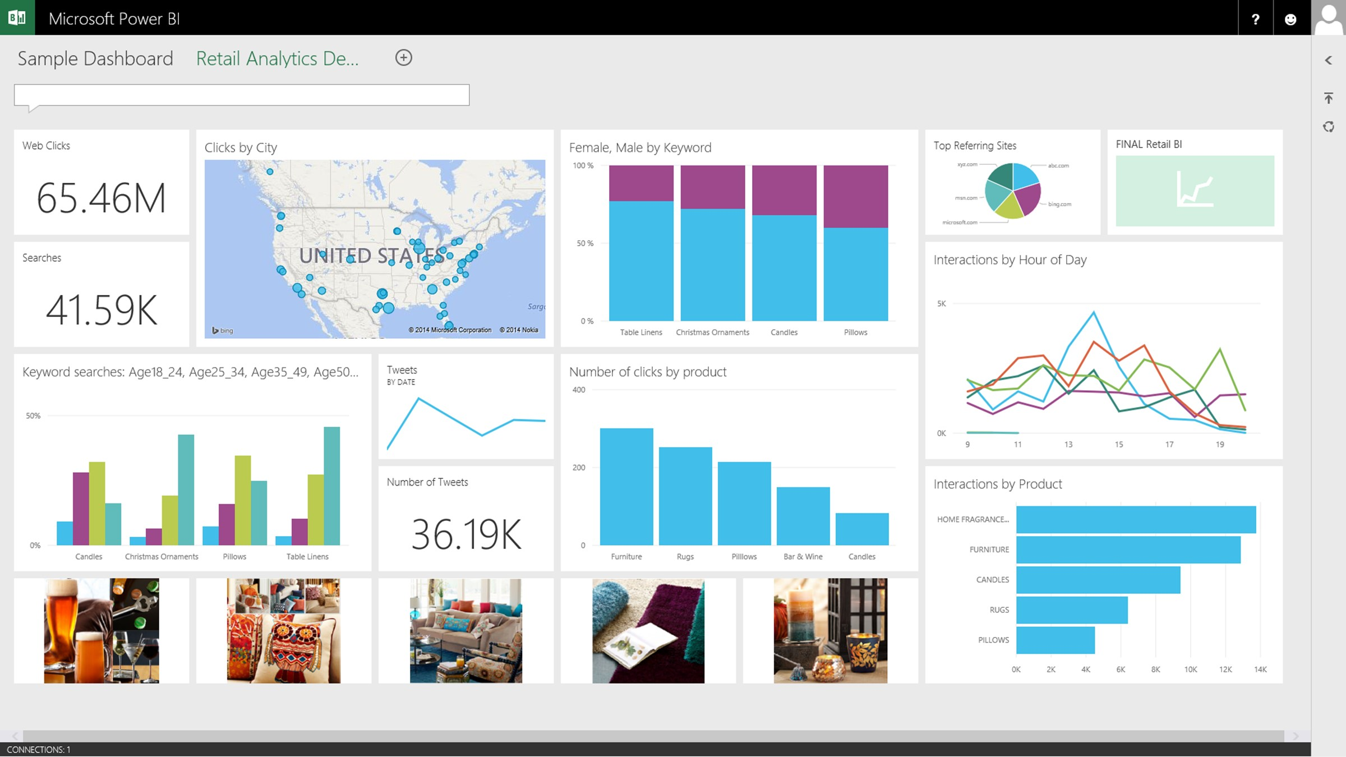

A relational data warehouse-as-a-service
Power BI
Hadoop
App Service
Azure SQL Database
Azure SQL Data Warehouse
Intelligent App
Azure Machine Learning
Notes:
Speaker notes:
Fully managed relational data warehouse-as-a-service.
Industry’s first elastic cloud data warehouse with enterprise-grade capabilities
Support your smallest to largest data sets

Slide 90
Elastic scale & 성능
Powered by the Cloud
저렴한 비용 및 성능
Petabyte의 데이터까지 확장
대규모 병렬처리
수초 내에 즉시 컴퓨팅 확장
관계형 및 비정형 쿼리
수분내에 실행
Azure ML PowerBI & ADF와 통합
기업환경 지원
컴퓨팅 및 저장소에 대한 단순 과금 정책
사용한 만큼만 지불, 필요할 경우 dynamic pause 사용
재개발이나 수정 없이 DW를 클라우드에서 활용

Slide 91
Data Lake
Data Lake

Slide 92
Azure Data Lake 서비스
대량의 데이터를 저장하고 관리
최초 형식(original format)으로 데이터 보관
대량 데이터 및 빠른 응답이 필요한 분석 작업에 적합
엔터프라이즈급 보안 및 접근 제어
Data Lake
Notes:
Speaker notes:
It’s as an enterprise wide repository of every type of data collected in a single place prior to any formal definition of requirements or schema.
Data is be kept without discrimination regardless of its size, structure, or how fast it is ingested.
Organizations can then use Hadoop or advanced analytics to find patterns of the data.
Azure Data Lake can be part of your existing data platform by leveraging Azure Active Directory as well as providing data replication to ensure high durability and availability.

Slide 93
Data Lake 서비스 대량 데이터를 변환 가능하도록 저장
HDInsight Service
Microsoft Revolution-R Enterprise
다른
분석 솔루션
SQL Data Warehouse
Data Lake
HDFS API
Notes:
Speaker notes:
HDFS for the Cloud: The Azure Data Lake is a Hadoop File System compatible with HDFS enabling Microsoft offerings such as Azure HDInsight, Revolution-R Enterprise, industry Hadoop distributions like Hortonworks and Cloudera all to connect to it.
Petabyte files, massive throughput: The goal of the data lake is to run Hadoop and advanced analytics on all your data to discover conclusions from the data itself.
Curated data: Azure Data Lake can also serve as a repository for lower cost data preparation prior to moving curated data into a data warehouse such as Azure Data Warehouse.

Slide 94
MongoDB, MySQL, Oracle, Cassandra, Neo4j and more
Notes:
There are other SQL Solutions you can choose to run in Azure. Official support exists for MySQL and Oracle.
(Good place to show the portal and that you can provision Oracle and MySQL databases in Azure just as easily as you can provision the Microsoft SQL options.

Slide 95
Azure에서 추가적인 데이터베이스 선택
Azure Table 서비스는 “Big Table” entity 저장소
MongoDB는 JSON document 저장소
Cassandra 복제 기능을 제공하는 column store 기반 저장소
Hbase는 HDInsight에서 사용 가능한 Big Data (Hadoop) 저장소
Azure에서 Oracle VM 공식지원
MySQL은 ClearDB 파트너를 통해 제공

Slide 96
Microsoft Azure Data Platform
SQL Database
SQL on IaaS
DocumentDB
Search
HDInsight
MongoDB, MySQL, Oracle, Cassandra, Neo4j and more
Notes:
As you can see there are a lot of options in the Microsoft Azure DataPlatform offerings. It may be a challenge to identify the most suitable options in every case but we can rest assured that there will be a good option for almost any scenario!

Slide 97
Try [service] today
Ask Questions:
Twitter:
Email
Public forum:

Slide 98
Q&A

Slide 100


Get started
Visit azure.microsoft.com

